Slide 1


PROMOTIONAL KIT

Slide 2



Customize your own banner to promote your participation at SECEC 2026!
  STEP 1: In the next slide click in the circle to insert your profile picture. Adjust the picture with “Crop” tool if needed.
  STEP 2: Enter your name, affiliation, or any message of your choice in the text box.
  STEP 3: Select all the items on the slide (CTRL+A), click right and hit “Save as picture”
  Your banner is ready to use.
  Please include the link to the SECEC Congress website, and tag #SECEC2026 and @secec_community

Slide 3
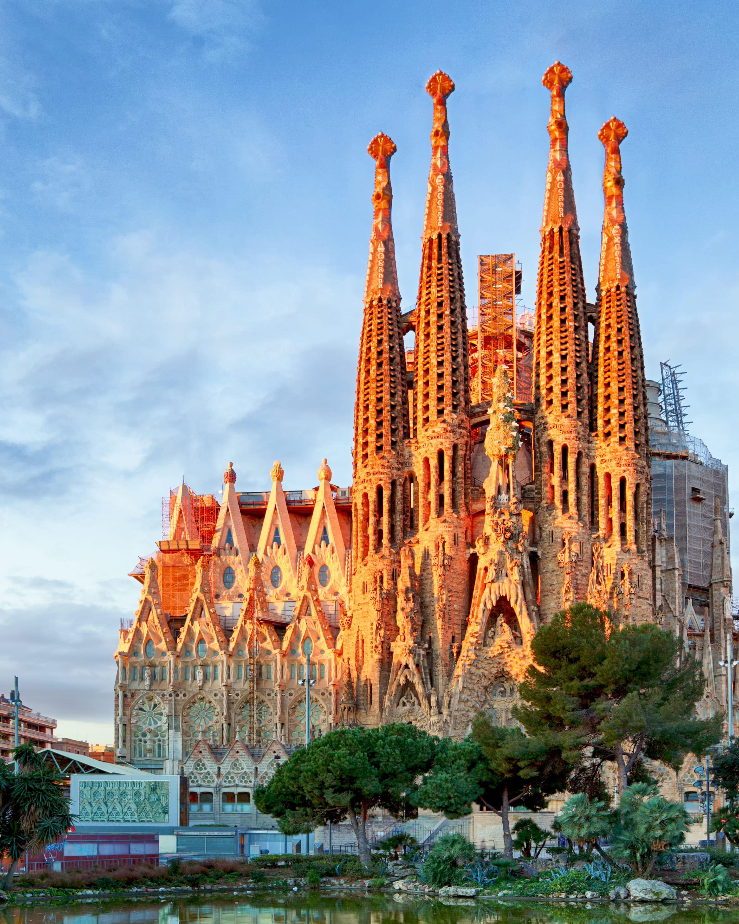
I am going to SECEC 2026
First name, Last name
Job title
SEE YOU IN BARCELONA!

Slide 4
I am speaking
at SECEC 2026
First name, Last name
Job title
SEE YOU IN BARCELONA!

Slide 5
My abstract is accepted
First name, Last name
Job title
SEE YOU IN BARCELONA!

Slide 6
I am presenting at SECEC 2026
First name, Last name
Job title
SEE YOU IN BARCELONA!

Slide 7
I am exhibiting at SECEC 2026
First name, Last name
Company
SEE YOU IN BARCELONA!

