Slide 1


SPEAKER KIT

Slide 2


Customize your own banner to promote your participation at SECEC 2026!
STEP 1: In the next slide click in the circle to insert your profile picture
STEP 2: Enter your name, affiliation, or any message of your choice in the text box
STEP 3: Select all the items on the slide (CTRL+A), click right and hit “Save as picture”
Your banner is ready to use.
Please include the link to the SECEC Congress website, and tag #SECEC2026

Slide 3
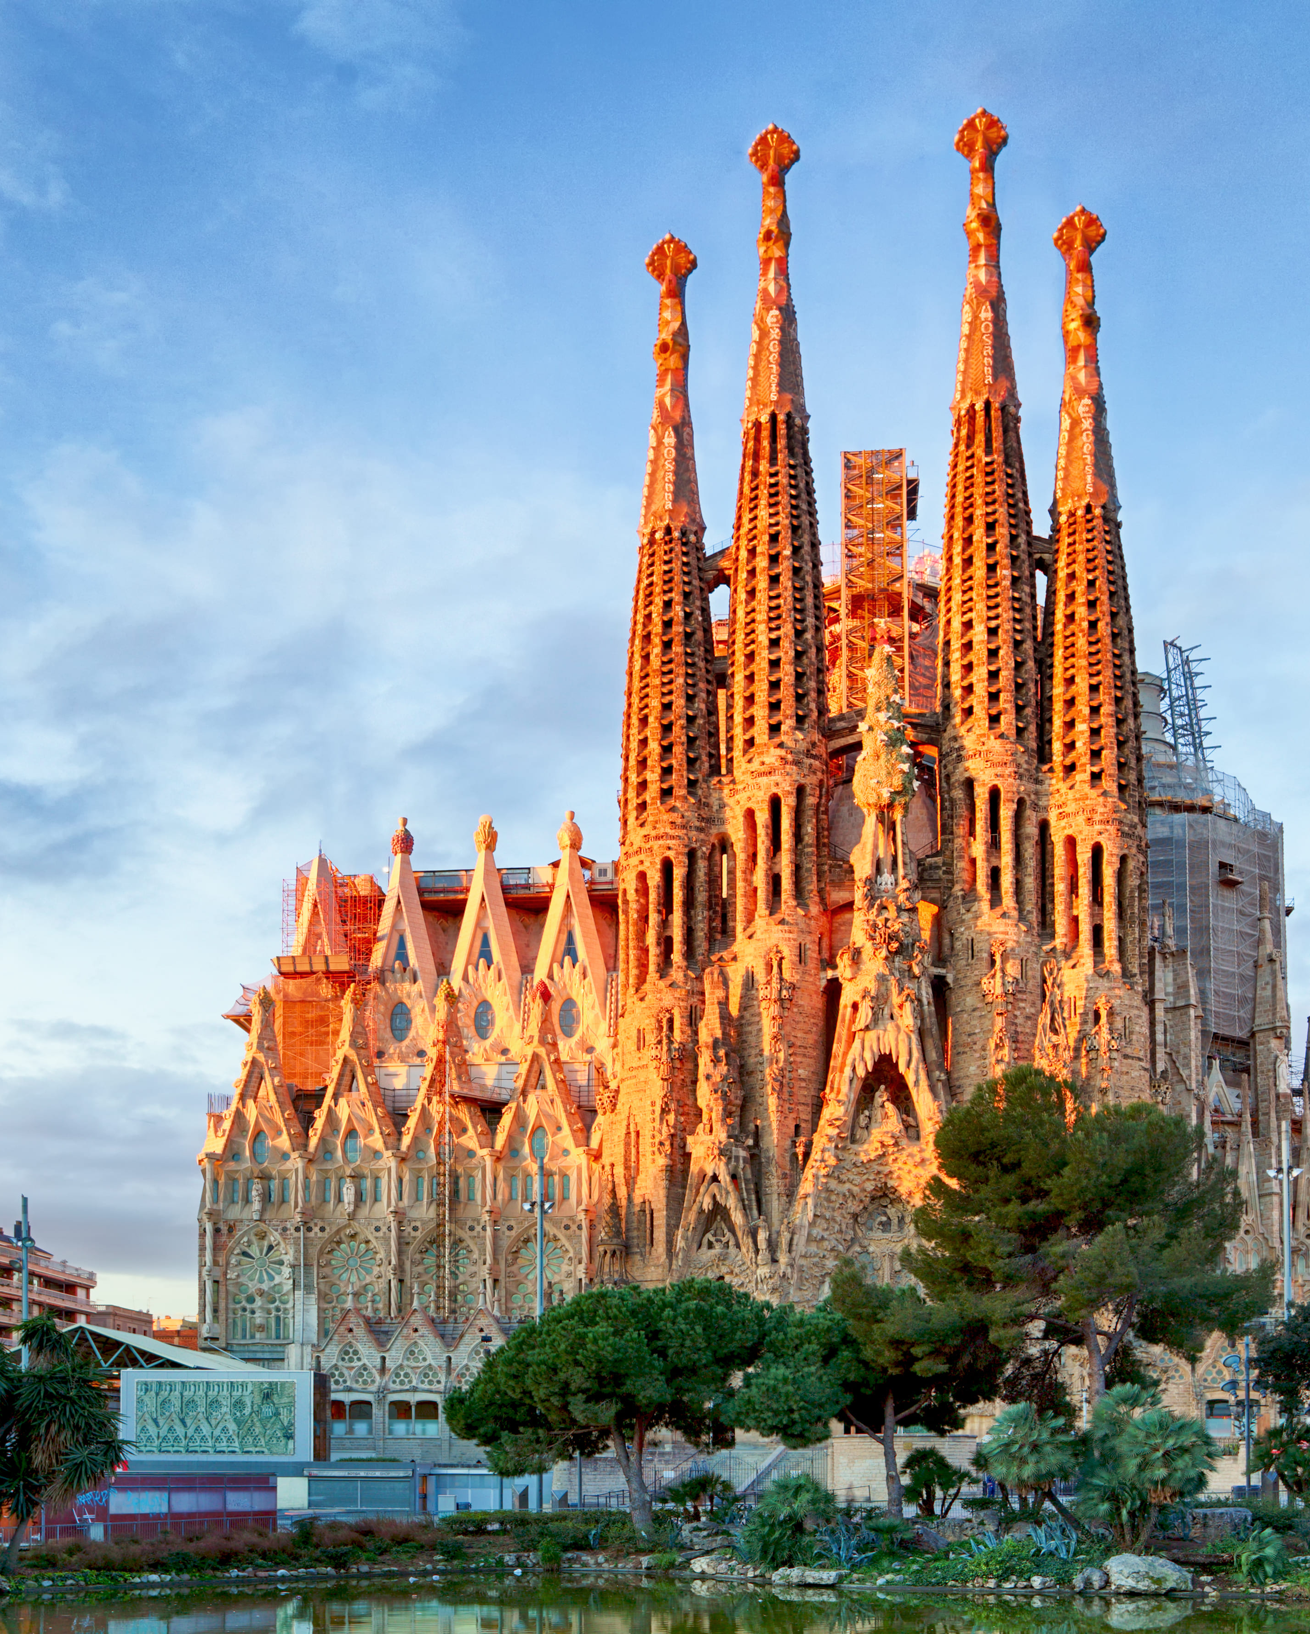
I am speaking
at SECEC 2026
First name, Last name
Job title
SEE YOU IN BARCELONA!

Slide 4
My abstract is accepted
First name, Last name
Job title
SEE YOU IN BARCELONA!

Slide 5
I am presenting at SECEC 2026
First name, Last name
Job title
SEE YOU IN BARCELONA!

